Slide 1



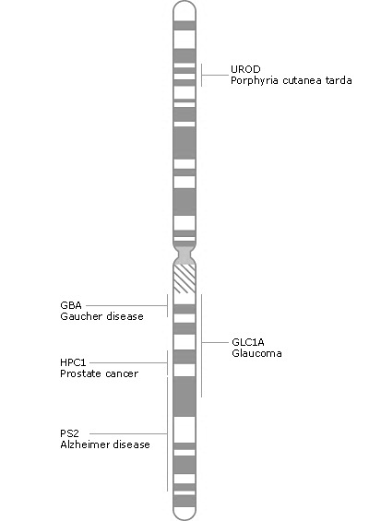

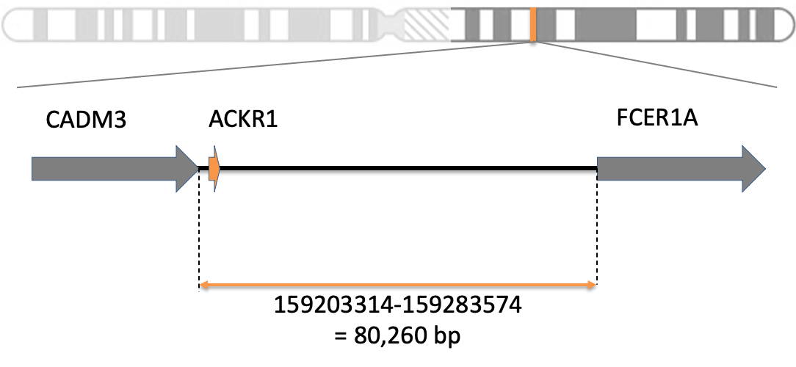
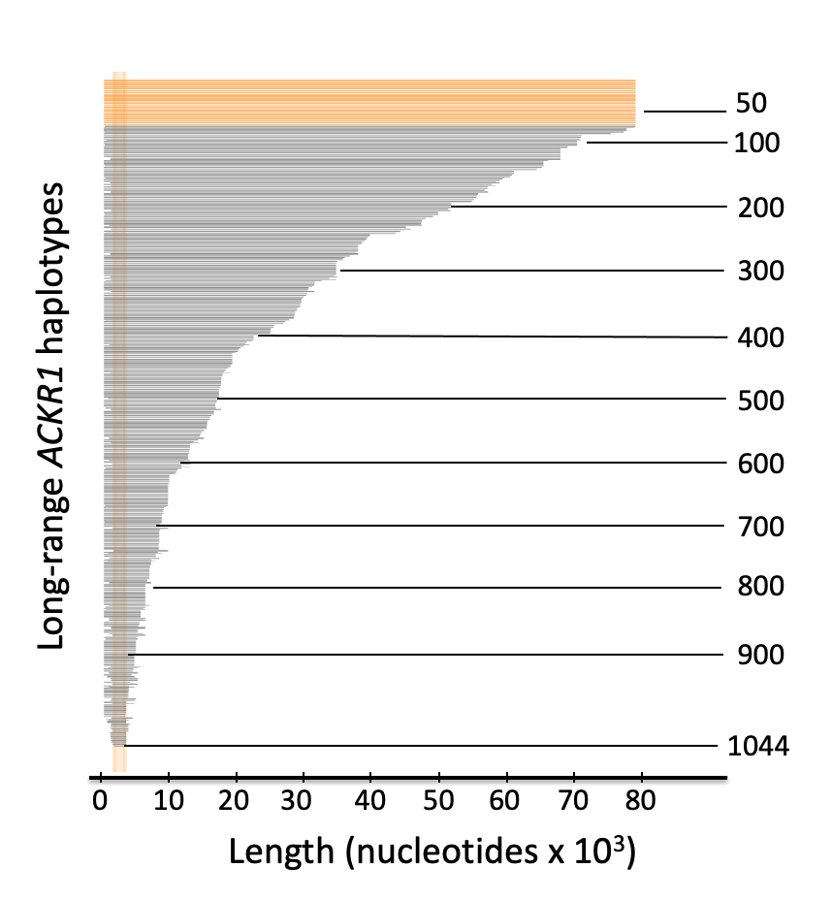
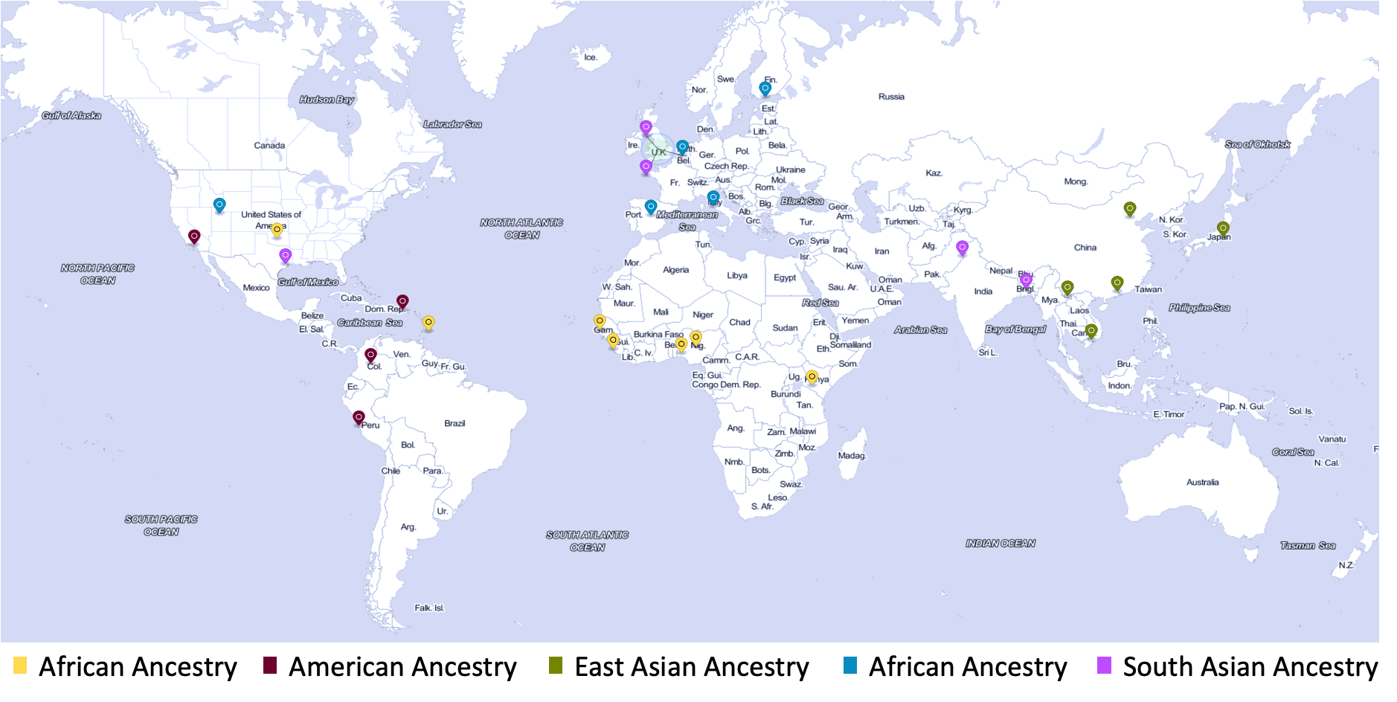
HapPy: Computational Haplotype Phasing using Long Contiguous Stretches of Homozygosity from the 1000 Genomes Project
Anne-Sophie Fratzscher^{1,2}, Kshitij Srivastava¹, Willy A. Flegel¹
¹Department of Transfusion Medicine, NIH Clinical Center, National Institutes of Health, Bethesda, MD
²McGill University, Montréal, QC
Goals
Methods
Conclusions
Identify conserved haplotype sequences across 26 different populations from the 1000 Genomes Project for genes on the long arm of chromosome 1
Construct long-range haplotypes using overlapping regions of full-length haplotypes
Step 1: Select all protein-coding genes from long arm of chromosome 1
Step 2: Generate haplotypes for genes using long contiguous stretches of homozygosity
Find the nucleotide length of all haplotypes.
Identify frequently occurring, long-range conserved haplotypes for all 26 populations of the 1000GP.
Identify the clinical importance of long conserved haplotypes in the blood transfusion donor-recipient setting.
extract protein-coding genes on long arm of chromosome 1
select a gene (e.g. ACKR1)
Background
select region between last nucleotide of previous gene and first nucleotide of next gene
The researchers claim the new reference dataset represents the full range of genetic variant types. It could facilitate population-specific studies on the genetic predisposition to different human diseases, and may inform on the development of novel strategies for personalized medicines targeted to individual genetic makeup
should better capture genetic differences from different human populations.
Haplotype phasing is the process of inferring haplotypes from genotype data
Haplotypes are sets of single nucleotide variations (SNVs) that are inherited together from a parent
Can be used to understand genetics of disease
Also important for blood group matching
Mostly done computationally due to cost and time of lab-based methods
Relies on correct reference sequence
The current human reference genome, Homo sapiens genome assembly GRCh38 (hg38), was released in 2013
Multiple concerns with the current reference genome:
Does not fully reflect human genetic diversity -> 70% from one individual
Most blood groups lack long reference sequences
The 1000 Genomes Project (1kGP) ran between 2008 and 2015 and sequenced 2504 unrelated individuals in Phase 3 dataset
Goal was to create public database of human genetic variation
Improved dataset was released in 2020 -> 30x WGS for 1kGP individuals + 698 additional samples = 3202 individuals
30x coverage (vs. 7.4X coverage for 1kGP phase 3) discovers over two-fold more SNV sites
Step 3: Build long-range haplotypes from full-length haplotypes for genes
Future Directions
get full-length haplotypes for subset of genes
Blood donor ACKR1 haplotypes can be matched with recipient haplotypes to determine most suitable donor.
Use of long-range conserved haplotypes in phasing of next generation sequencing data.
1000 Genomes 30x on GrCH38
Fetch data
genotype data for gene (3202 individuals)
Extract unambiguous haplotypes by selecting individual sequences with a single site of heterozygosity or complete heterozygosity
Clinical Implications
Bo Lan would like to thank Dr. Willy Flegel and Dr. Kshitij Srivastava for their tremendous efforts in providing him with the experience of working in a transfusion medicine laboratory setting and in the incredible mentorship they have provided him throughout his project.
Acknowledgements
References
Srivastava K, Fratzscher AS, Lan B, Flegel WA. Cataloguing experimentally confirmed 80.7 kb-long ACKR1 haplotypes from the 1000 Genomes Project database. BMC Bioinformatics. 2021 May 26;22(1):273
. Srivastava K, Wollenberg KR, Flegel WA. The phylogeny of 48 alleles, experimentally verified at 21kb,and its application to clinical allele detection. J Transl Med. 2019 Feb 11; 17(1):43
.
Auton, A. and Abecasis, G. R., et al. A global reference for human genetic variation. Nature 526, 68–74 (2015).
Results
Identify conserved haplotype sequences in and around the ACKR1 gene.
From conserved haplotype sequences, construct longest available haplotype for the ACKR1 gene and adjacent intergenic regions in 26 different populations of the 1000 Genomes Project (1000GP).
Find the population representation of each distinct haplotype in the 1000GP.
Figure 1: Locations of populations for 1kGP 30x on GRCh38
Conclusions
Notes:
Chromosome 1 figure: https://www.ncbi.nlm.nih.gov/books/NBK22266/
SOURCES: https://www.ncbi.nlm.nih.gov/grc/help/faq/#human-reference-genome-individuals
https://ashpublications.org/blood/article/133/17/1814/275900/Blood-group-genotyping
https://www.internationalgenome.org/announcements/3202-samples-at-high-coverage-from-NYGC/

Slide 2
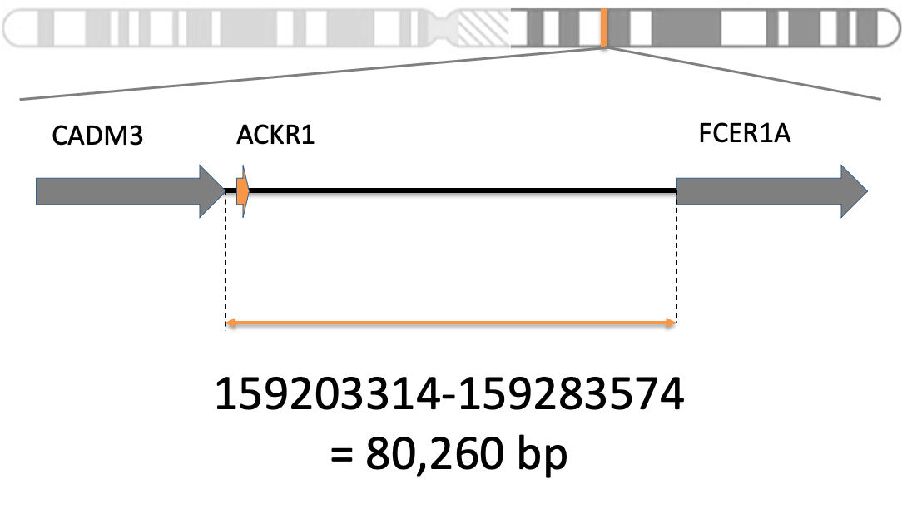

HapPy: Computational Haplotype Phasing using Long Contiguous Stretches of Homozygosity from the 1000 Genomes Project
Anne-Sophie Fratzscher^{1,2}, Kshitij Srivastava¹, Willy A. Flegel¹
¹Department of Transfusion Medicine, NIH Clinical Center, National Institutes of Health, Bethesda, MD
²McGill University, Montréal, QC
Goals
Methods
Conclusions
Identify conserved haplotype sequences across 26 different populations from the 1000 Genomes Project for genes on the long arm of chromosome 1
Construct long-range haplotypes using overlapping regions of full-length haplotypes
Figure 2: Diagram of the HapPy Pipeline
Description
Find the nucleotide length of all haplotypes.
Identify frequently occurring, long-range conserved haplotypes for all 26 populations of the 1000GP.
Identify the clinical importance of long conserved haplotypes in the blood transfusion donor-recipient setting.
ss
GRCh38 assembly
select a gene (e.g. ACKR1)
Background
Haplotype phasing is the process of inferring haplotypes from genotype data
Haplotypes are sets of single nucleotide variations (SNVs) that are inherited together from a parent
Can be used to understand genetics of disease
Also important for blood group matching
Mostly done computationally due to cost and time of lab-based methods
Relies on correct reference sequence
The current human reference genome, Homo sapiens genome assembly GRCh38 (hg38), was released in 2013
Multiple concerns with the current reference genome:
Does not fully reflect human genetic diversity -> 70% from one individual
Most blood groups lack long reference sequences
The 1000 Genomes Project (1kGP) ran between 2008 and 2015 and sequenced 2504 unrelated individuals in Phase 3 dataset
Goal was to create public database of human genetic variation
.
Improved dataset was released in 2020 -> 30x WGS for 1kGP individuals + 698 additional samples = 3202 individuals
30x coverage (vs. 7.4X coverage for 1kGP phase 3) discovers over two-fold more SNV sites
1kGP 30x
Future Directions
get results for all genes
Expand to the remaining genes on chromosome 1, eventually to all genes
genotype data for gene (3202 individuals)
select full-length haplotypes
Clinical Implications
Blood donor ACKR1 haplotypes can be matched with recipient haplotypes to determine most suitable donor.
Use of long-range conserved haplotypes in phasing of next generation sequencing data.
long-range haplotypes
repeat for other genes
Acknowledgements
References
Results
Srivastava K, Fratzscher AS, Lan B, Flegel WA. Cataloguing experimentally confirmed 80.7 kb-long ACKR1 haplotypes from the 1000 Genomes Project database. BMC Bioinformatics. 2021 May 26;22(1):273
. Srivastava K, Wollenberg KR, Flegel WA. The phylogeny of 48 alleles, experimentally verified at 21kb,and its application to clinical allele detection. J Transl Med. 2019 Feb 11; 17(1):43
.
Auton, A. and Abecasis, G. R., et al. A global reference for human genetic variation. Nature 526, 68–74 (2015).
Identify conserved haplotype sequences in and around the ACKR1 gene.
From conserved haplotype sequences, construct longest available haplotype for the ACKR1 gene and adjacent intergenic regions in 26 different populations of the 1000 Genomes Project (1000GP).
Find the population representation of each distinct haplotype in the 1000GP.
Figure 1: Population Distribution for 1kGP 30x
The researchers claim the new reference dataset represents the full range of genetic variant types. It could facilitate population-specific studies on the genetic predisposition to different human diseases, and may inform on the development of novel strategies for personalized medicines targeted to individual genetic makeup
should better capture genetic differences from different human populations.
Notes:
Chromosome 1 figure: https://www.ncbi.nlm.nih.gov/books/NBK22266/
SOURCES: https://www.ncbi.nlm.nih.gov/grc/help/faq/#human-reference-genome-individuals
https://ashpublications.org/blood/article/133/17/1814/275900/Blood-group-genotyping
https://www.internationalgenome.org/announcements/3202-samples-at-high-coverage-from-NYGC/

Slide 3
CADM3
ACKR1
FCER1A
159203314-159283574
= 80,260 bp

Slide 5
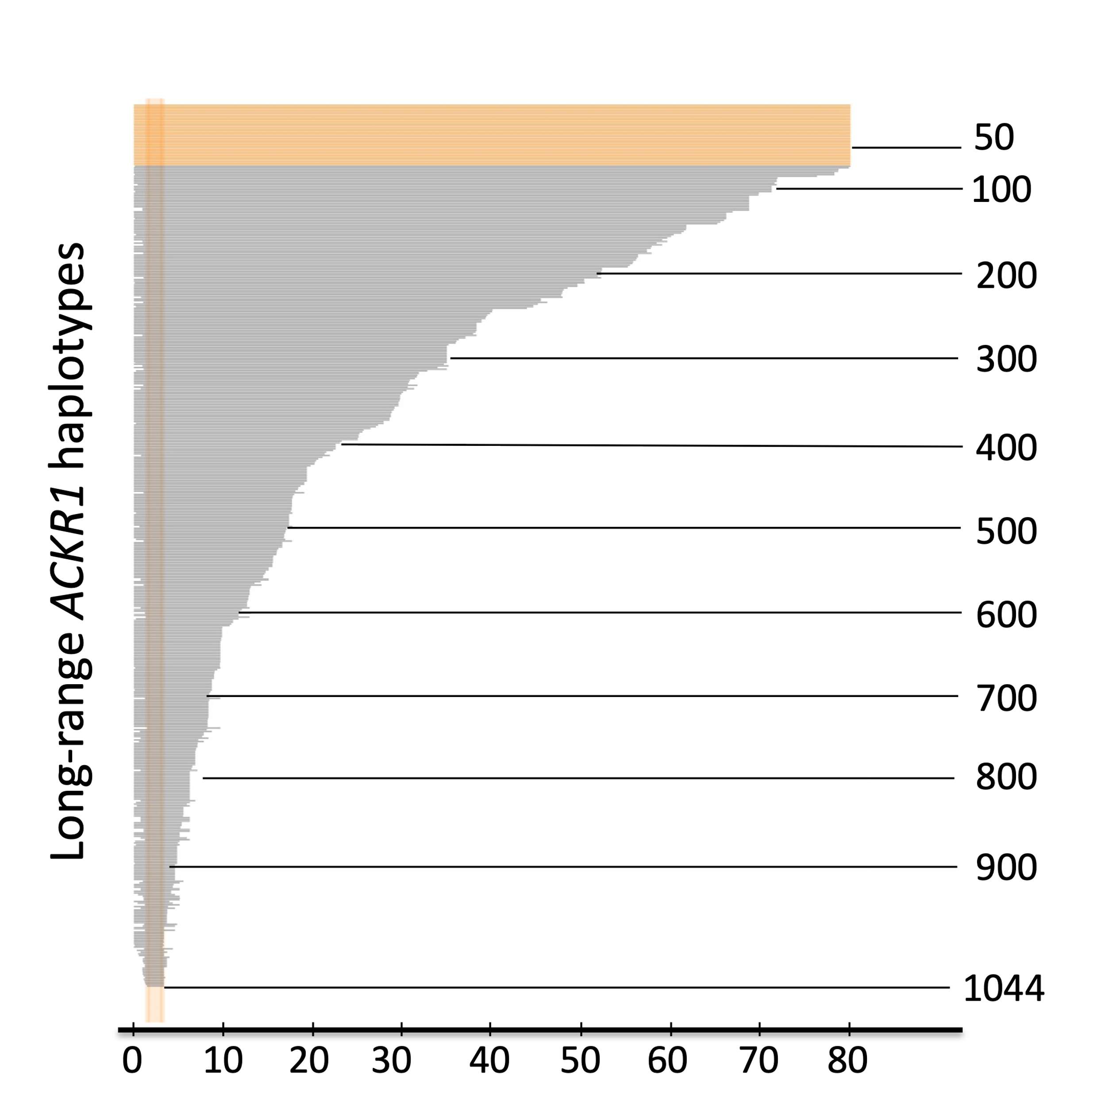
50
100
200
Long-range ACKR1 haplotypes
300
400
500
600
700
800
900
0
10
20
30
40
50
60
70
80
1044
Length (nucleotides x 10³)

Slide 6
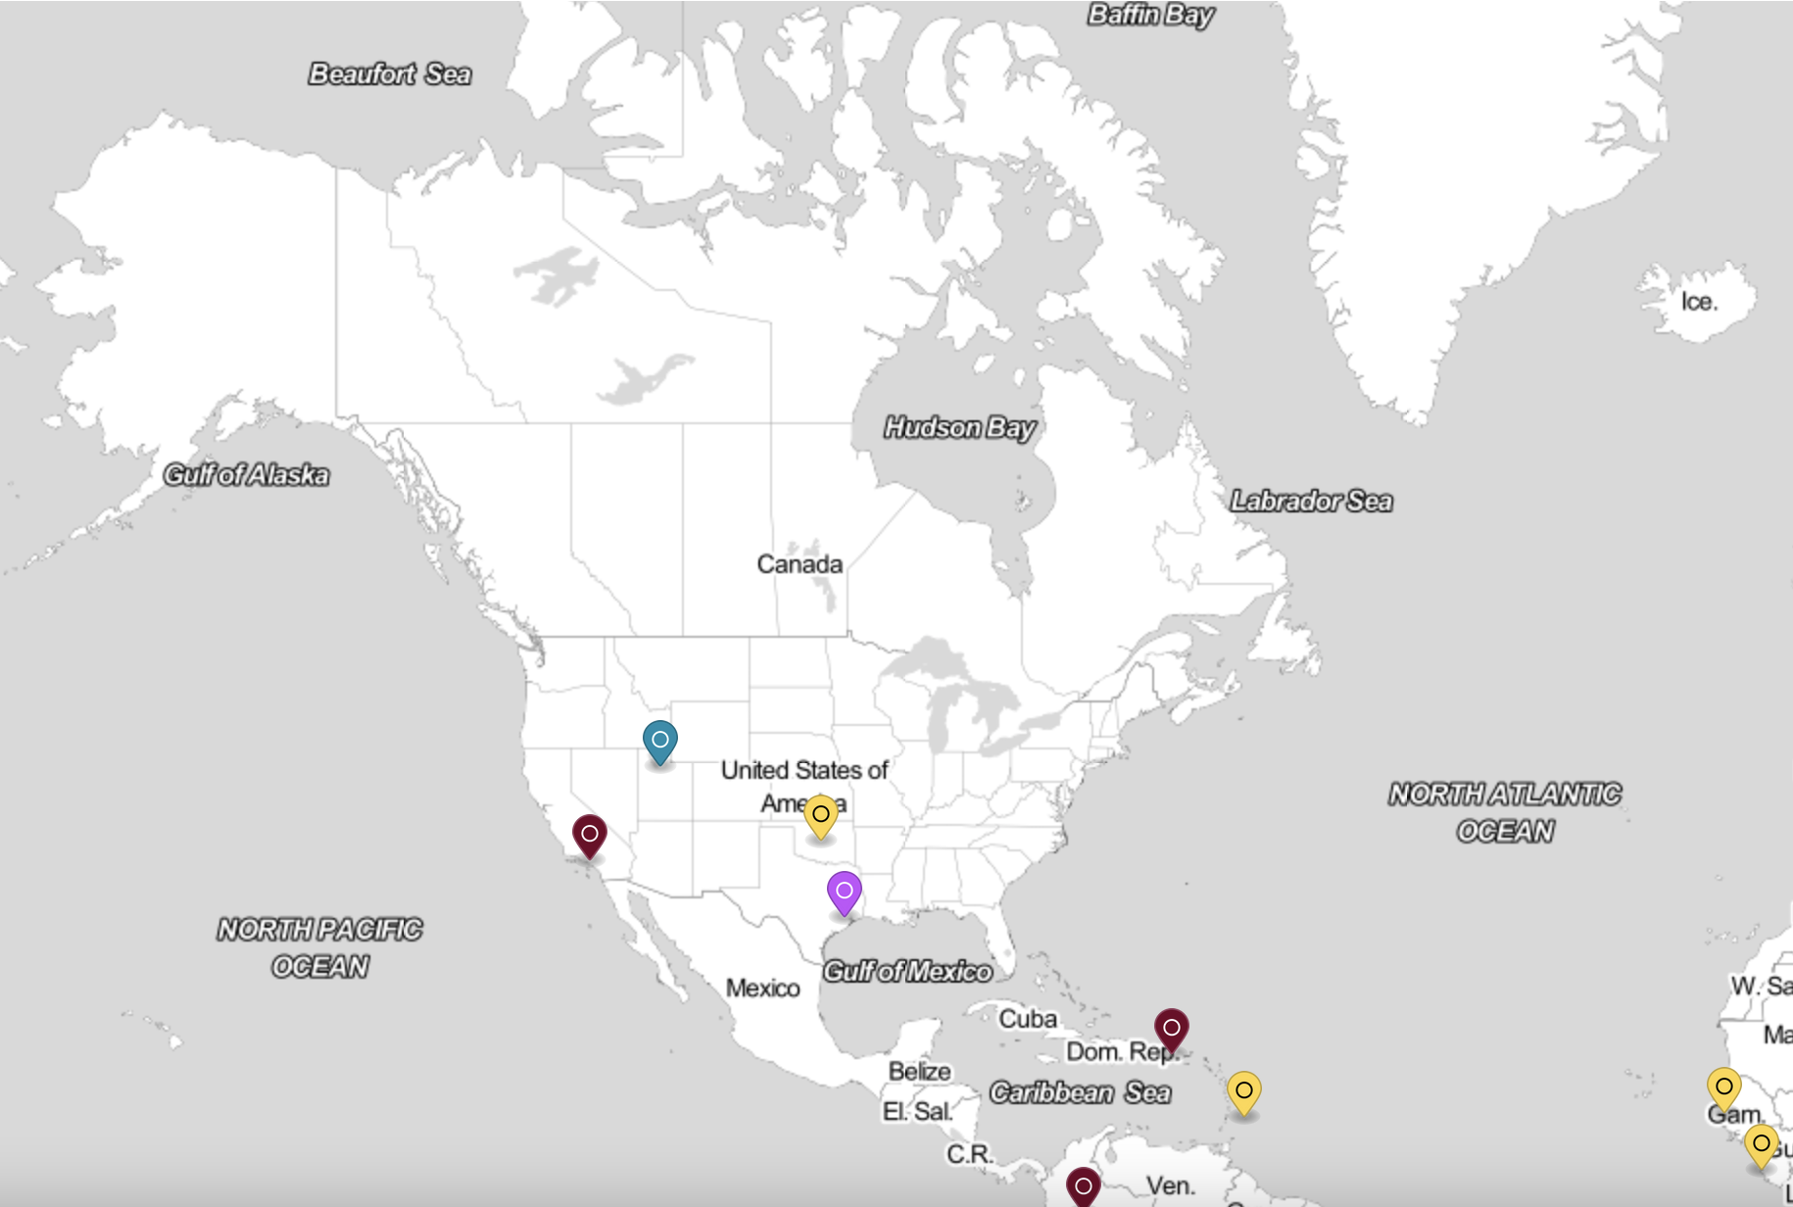
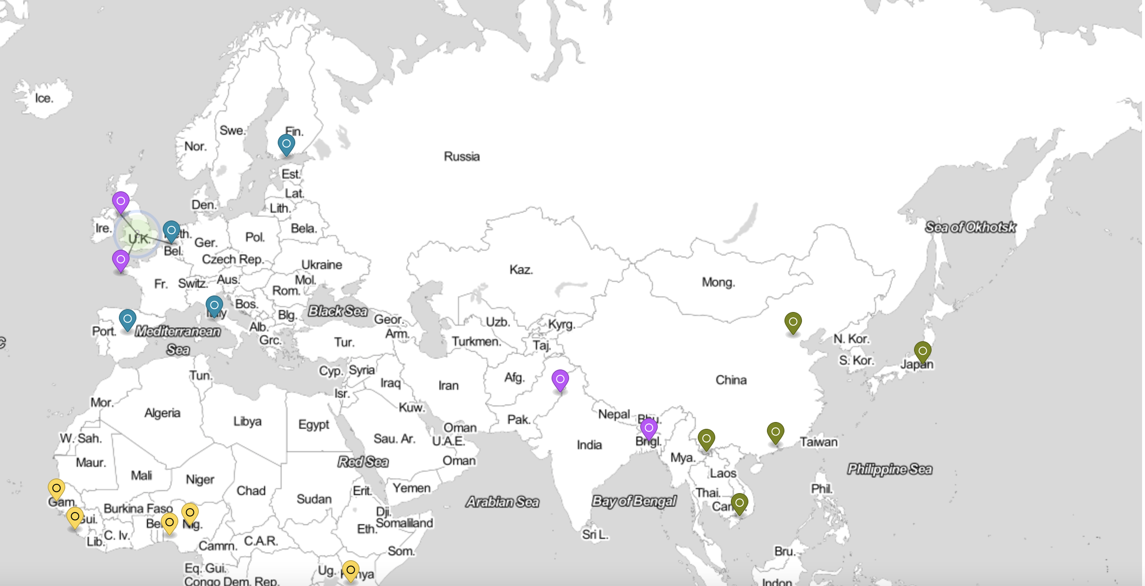
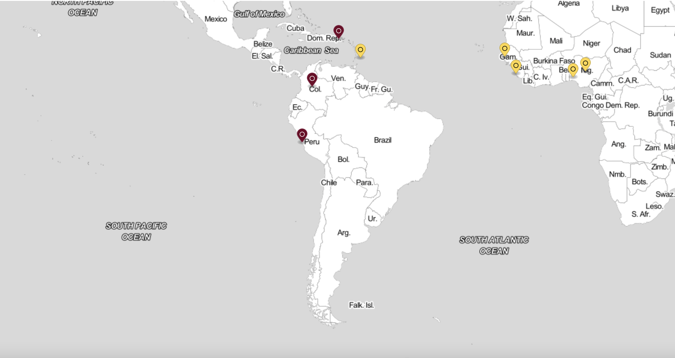
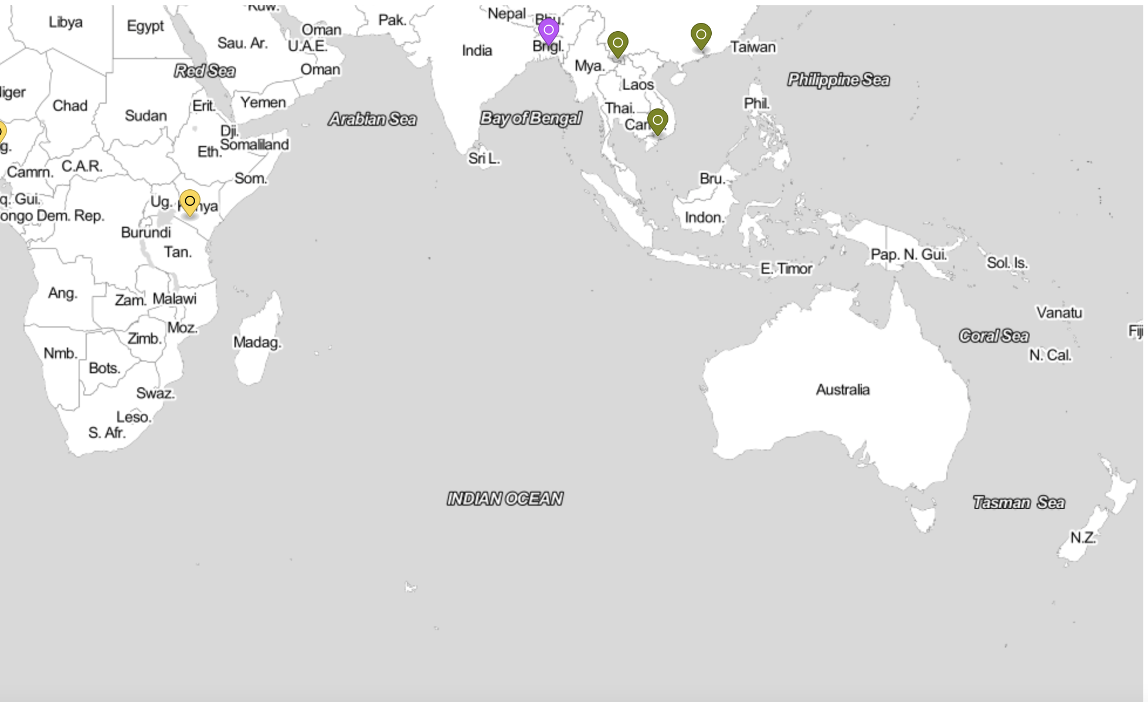
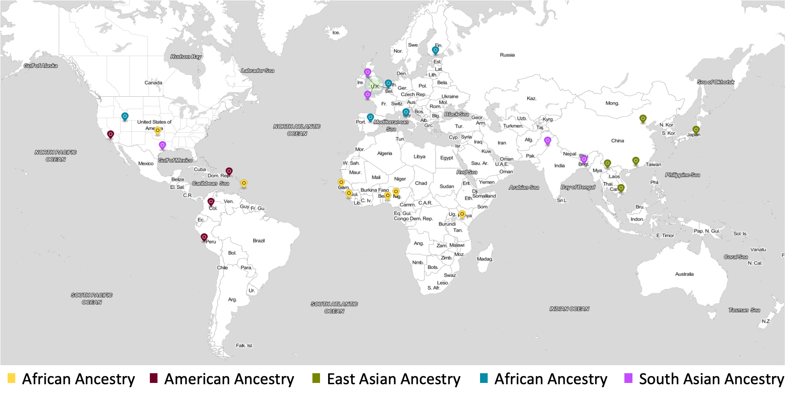
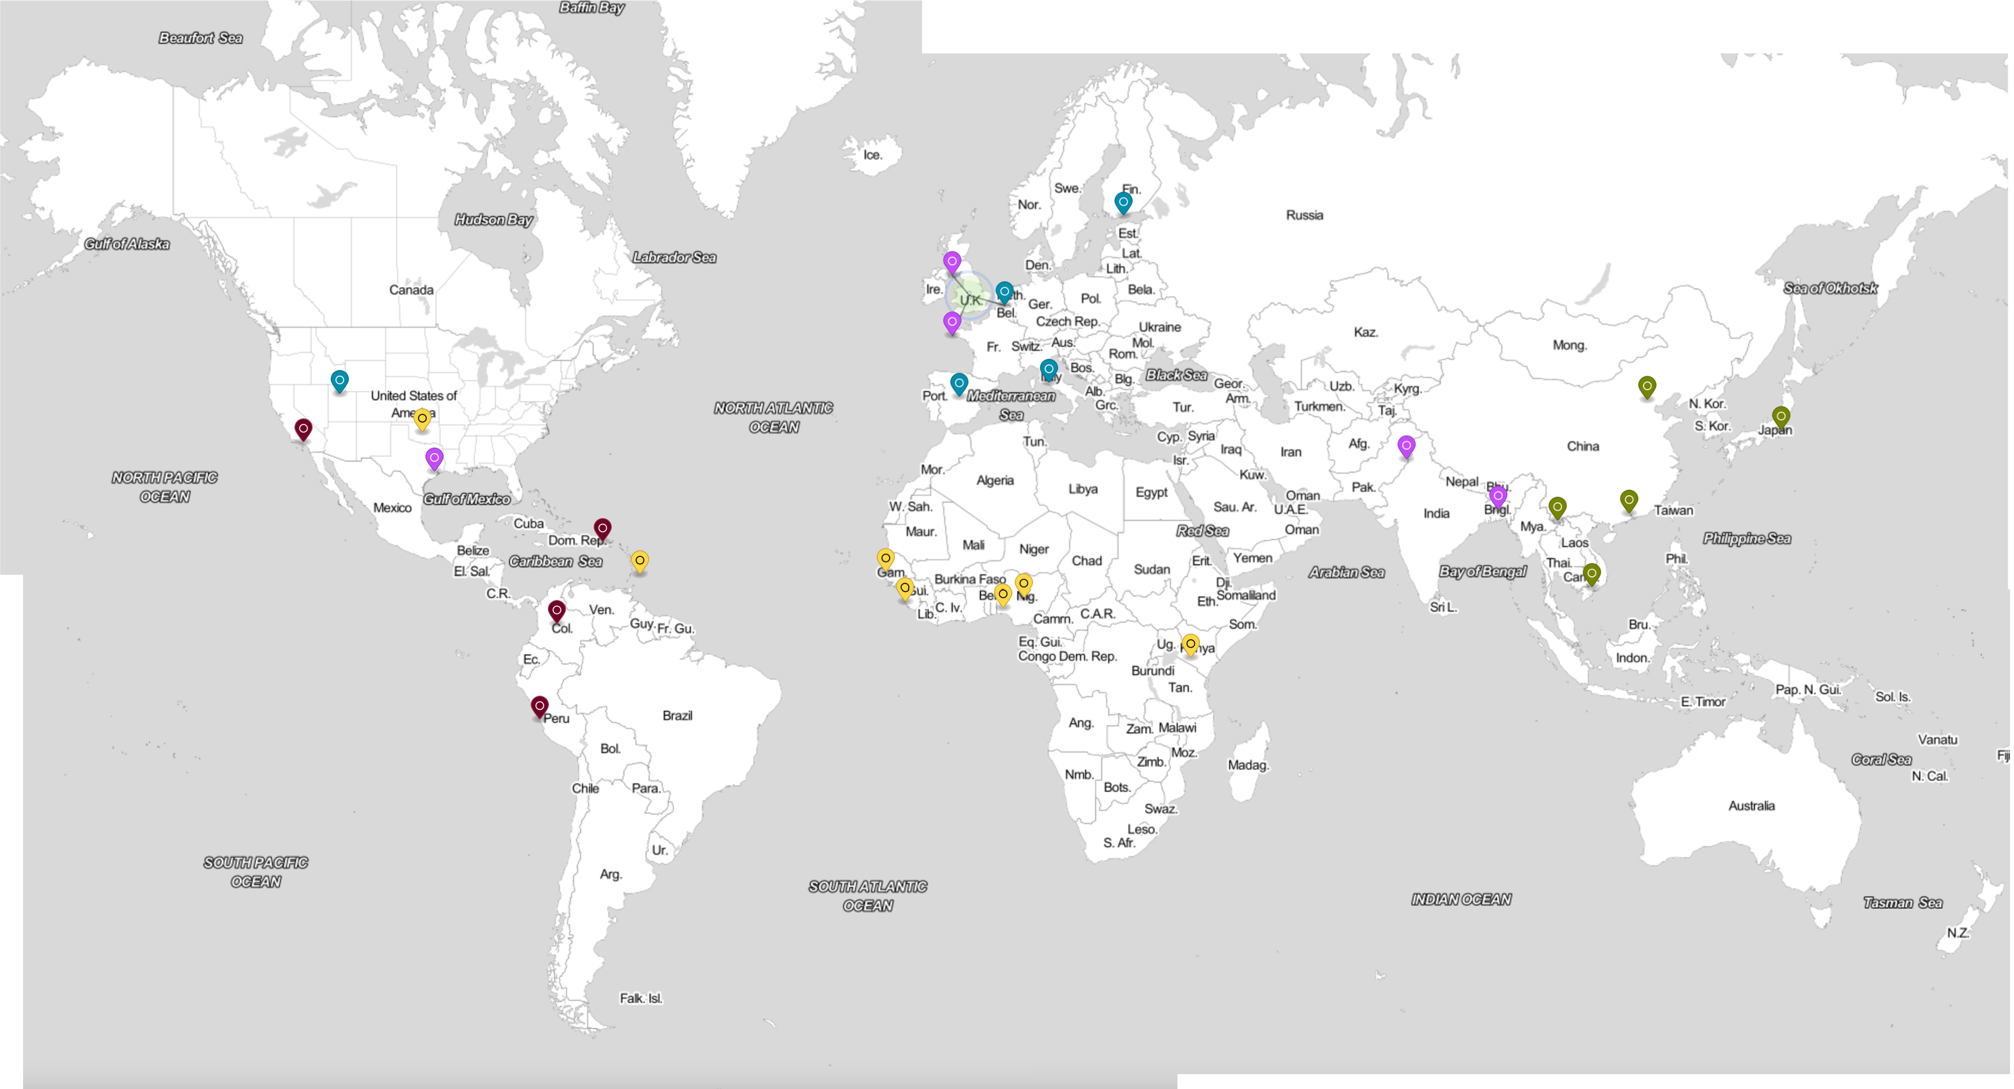
Figure 1: Locations of populations for 1kGP 30x on GRCh38
African Ancestry
American Ancestry
East Asian Ancestry
African Ancestry
South Asian Ancestry

